Slide 1
IOCCG 2016
Santa Monica
CNES OCEAN program STATUs
Thierry Carlier & Philippe Escudier
Thierry.carlier@cnes.fr
Philippe.escudier@cnes.fr

Slide 2
CNES Ocean program major events since previous IOCCG
Launches :
Jason 3 successful launch, January 17th, 2016
In orbit verification on going
CNES conducts operation till LEOP end
Sentinel 3 A successful launch, Feb 16th, 2016
On going instruments set up and verification
CNES supports Calval : altimetry + Ocean Color (OLCI)
Programmatic decisions :
Saral/Altika mission extension (2 years) : Feb 2016
SWOT phase C/D decision : mid 2016
CFOSAT : system CDR end 2016
New programs :
OCAPI proposal for ESA EE9 AO
COSPACE prospective
Science support
SWOT Science Team selected for the 2016 – 2020 timeframe
Continuous support of science activities related to our space activities through Tosca AO
Calval activities : ie Boussole or Coriolis program (Argo, Bio Argo, marine mammals…)
Future missions preparation
Missions Valorization

Slide 3
CNES Ocean program Prospective
Science prospective seminar organized in La Rochelle, 2014,
COSPACE (Government-Industry Consultation Committee for Space activity) has set up a group to make recommendations for short/medium/long term decisions concerning space programs applied to ocean. Work on going, final report being reviewed.
Main outcomes :
First generation of measurements systems proved the value of space observations for ocean monitoring and management :
Physics of the ocean : altimetry, SST, sea state, surface current
Bio geochemistry : ocean color, salinity,
➔ operational monitoring systems now in place, benefiting from these techniques :
Ocean analysis and forecast centers,
Copernicus program in Europe : long term commitment, global coverage with high revisit time, multi-parameters, open and free data policy,
New challenges to be met to answer societal needs :
Integrated view :
Dynamics and biology
Air - Sea interaction
Continent - Sea interactions, costal areas
For that a major technical challenge is improvement in space and time resolution, main goals :
Improvement by a factor of ten of altimetry space and time resolution capacity
Improvement by a factor of ten of ocean color time resolution,
Geostationary observations to complement LEOs

Slide 4
OCAPI Programmatic Context
CNES Science Prospective Seminar in 2014 confirmed OCAPI as a “short term” priority for Earth Observation Program
Decision in spring 2015 to start complementary studies with the objective to take opportunity of proposal submission to the ESA Earth Explorer 9 program
Call for Proposals for the Earth Explorer Mission EE-9 released in November 2015
Letters of Intent to be sent to ESA by Feb, 1st
Proposal submission due for the 24th of June 2016
Selection : End of 2016 (up to 3 proposals selected for phase A studies)
Final selection : Likely mid of 2018
Launch timeframe : 2024
An OCAPI Proposal managed by David Antoine (Laboratoire d'Océanographie de Villefranche (LOV)) with support of a Science team (Experts from Europe) & CNES technical Experts is under preparation.
OCAPI Letter of Intent sent to ESA
First science team coordination meeting held in Paris on the 5th of February
CNES industry Study to assess the mission feasibility

Slide 5
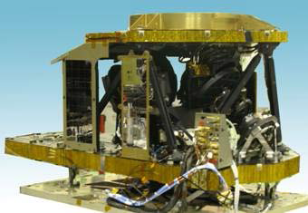
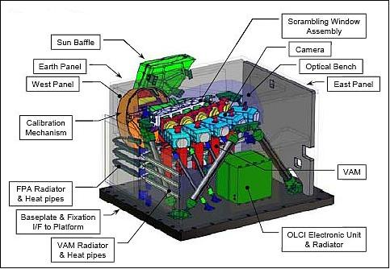
OCAPI CNES Study On Going Activities
Two competitive contracts are currently running with French companies : Airbus Defence & Space (ADS) and Thalès Alenia Space (TAS)
Trade-off between mission requirements and instrument concept
Feasibility analysis for the accommodation of the instrument onboard commercial Host Platform
Development plan elaboration and CaC assessment including host fees
To be completed by mid April 2016
GOCI-1 & GOCI-2 programs led by Airbus D&S for KARI (South Korea)
Sentinel-3 OLCI program led by TAS for ESA

Slide 6
OCAPI CNES study main results
Instrument concept compatible with the main mission requirements :
1 hour revisit and overall disk imaging (Ocean and costal areas)
250 m spatial sampling @ Nadir
13 bands from 412 to 1020nm, with filter wheel for bands selection,
New SNR requirements and MTF =0,15
Instrument compatible with telecommunication host satellite (150kg, 250W) thanks to specific adaptations :
Need of isolators beneath the instrument to filter the high frequency perturbations
Need of images processing or line of sight compensation

Slide 7
Potential Flight opportunities Analysis for an Ocapi like hosted payload
Assumptions :
Orbital slot : +/- 15°
Launch window 2023-2025
Telecom commercial satellite on geostationary orbit
→ up to 3 per year identified potential telecommunication S/L

Slide 8
International collaboration for global geostationary Ocean Color measurement
To get global coverage from geostationary orbit an international collaboration should be implemented :
Minimum of 3 satellites required positioned at coordinated locations
➔ similar to atmospheric observations from geo orbit
To allow global science and societal applications, a common set of missions definition elements is a key asset
Spectral Bands definition, …
Calval
Data access
IOCCG role and support to be discussed :
Overall recommendation for such a virtual constellation
Specific support to individual initiatives : Geocapi, Geoape, GOCI II
Building on previous group reports to promote key mission definition elements

Slide 9
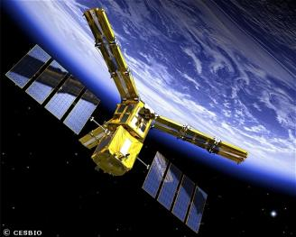
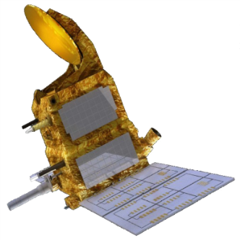
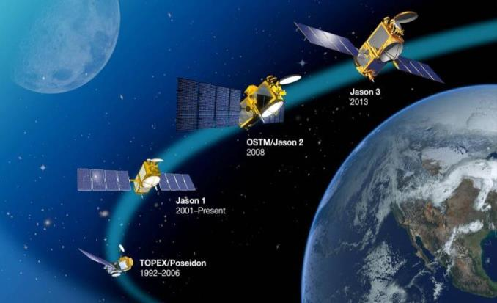
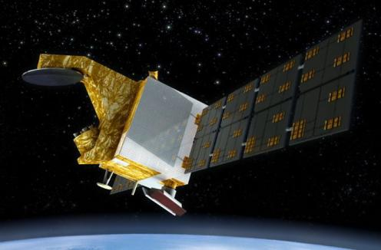
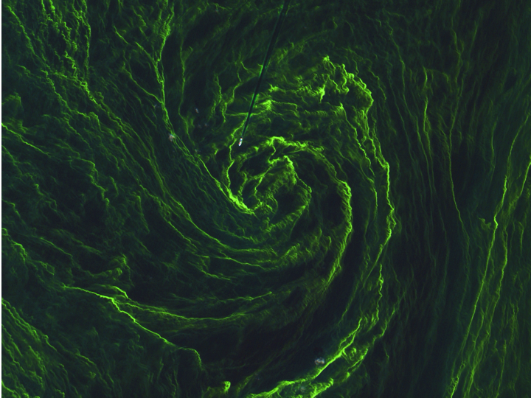
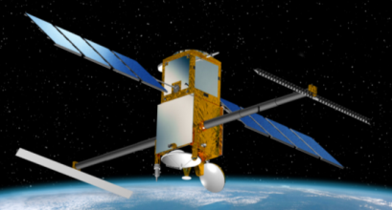
Thank you !
S2 image over the Baltic

